Slide 1
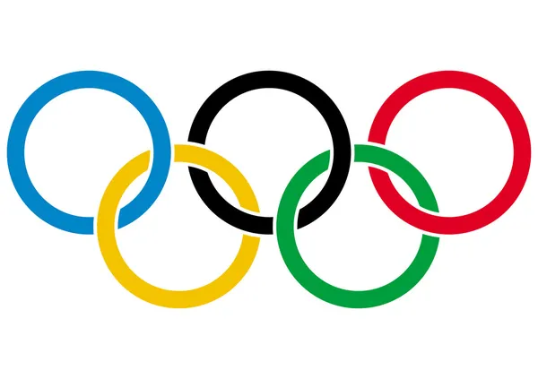

Who Makes Up Olympians?
Project Four Team Members - Clay Langdon, Chris Manfredi, Anusha Sekhar
Allison Potestio, Susan Ombwayo, Aleksey Kozhokin
Susan

Slide 2

Project Overview
Susan
Our team reviewed a csv data set that contained Olympic participants information from 1896 to 2016
Questions we wanted to understand about the data were:
What sports are the most popular?
Are there any underlying factors between Summer & Winter games?
What countries have had success through the years?
Does a person’s sex factor into their success?
Does Age Matter?
Finding the average optional age & identify outliers
Distribution of ages in Summer vs Winter Olympics
Exploring height & weight in correlation with age
Medal counts by age

Slide 3
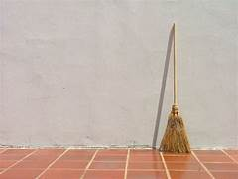
Cleaning our Data
CSV Data Included 275K+ rows of Olympic Data including:
Name, Sex, Age, Height, Weight, Team, NOC, Games, Year, Season, City, Sport, Event,Medal
Cleaned Up Data Removing NAs in Age, Weight, Medals
Methods for Data Cleaning:
Merging multiple CSVs to isolate country names & geography with participants information
Drop unused columns (some data columns that had fields with blank, N/A, or NaN were simply removed if not applicable to our achieved findings
Replaced Null's; Clean DataFrames based on relevance to analysis
Binning
Subset Data Frames

Slide 4
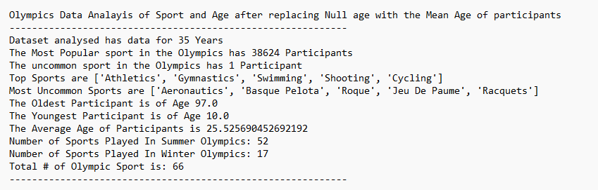
Olympics Data Exploration: Overview
Anusha

Slide 5
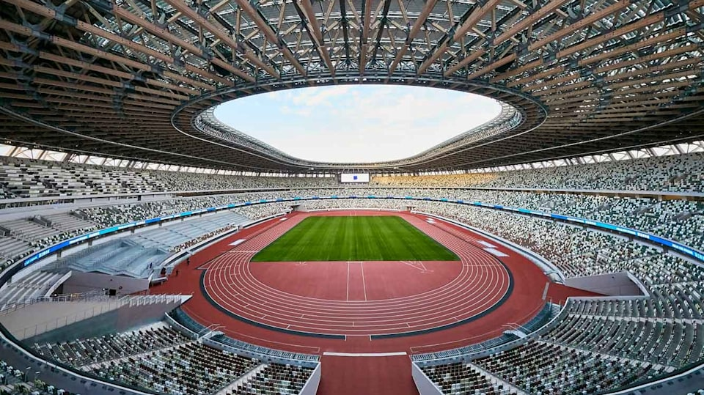
Overview Analysis

Slide 6
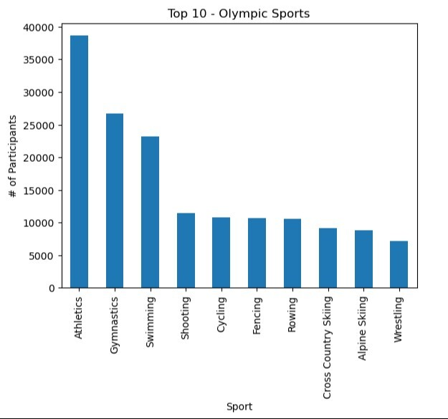
Key Visualizations – Top Sports By Participation
Anusha

Slide 7
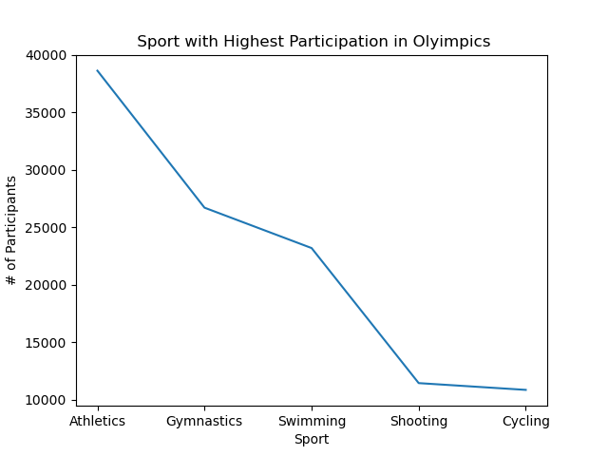
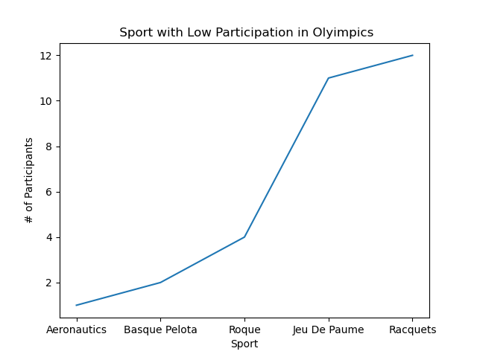
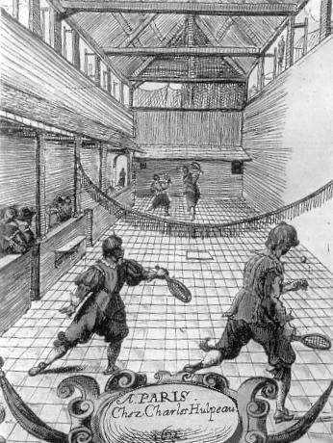
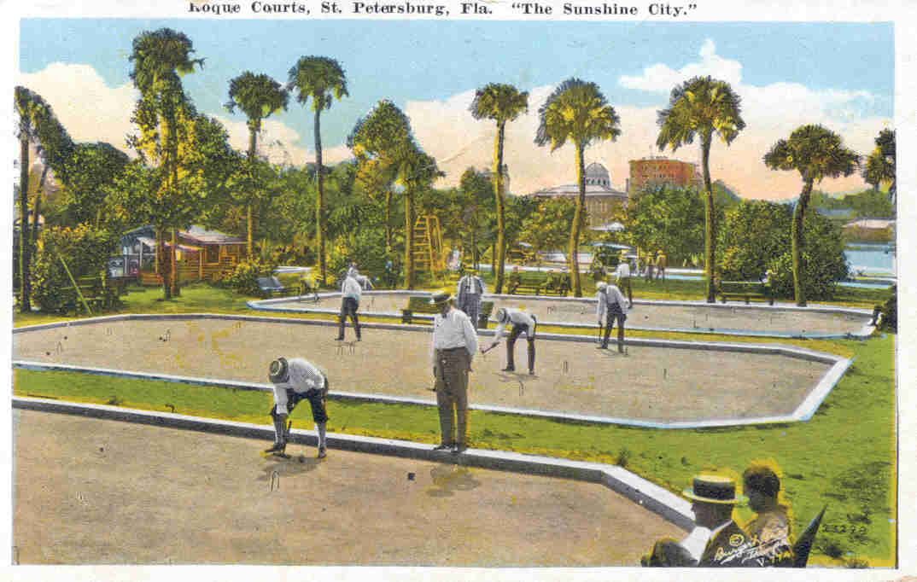
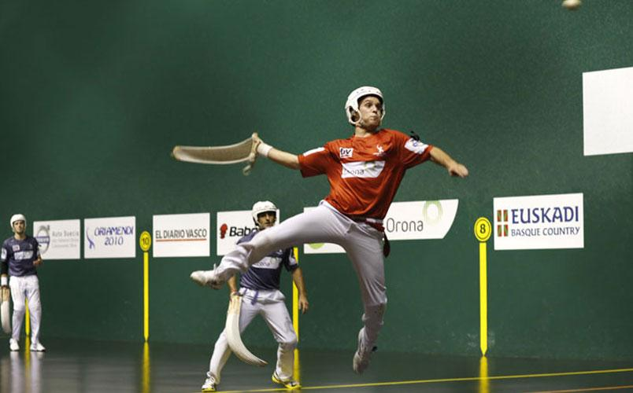
Sports w/ Highest & Lowest Participation
Anusha

Slide 8
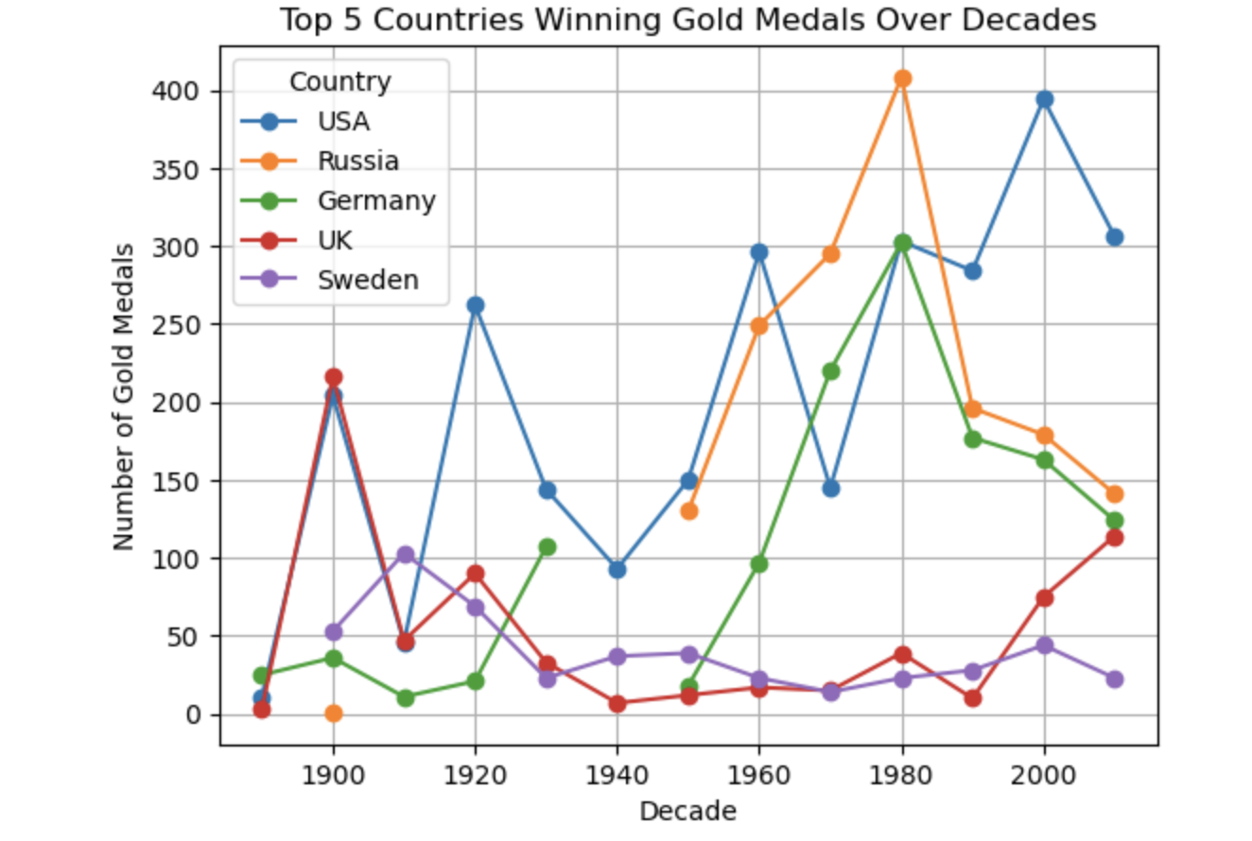
Countries Over Time - Medal Count
Alex

Slide 9

Age Analysis

Slide 10
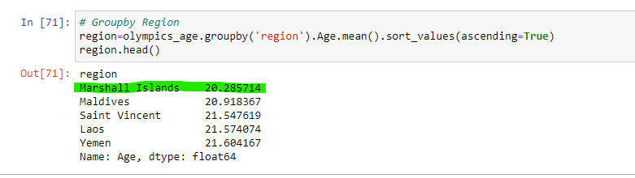

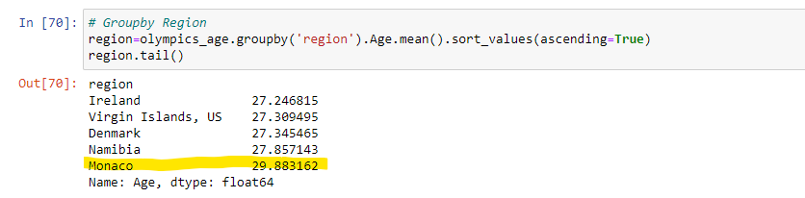
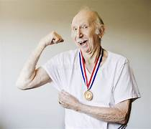
Average Ages by Country
What country has the average youngest participants?
What country has the average oldest participants?

Slide 11
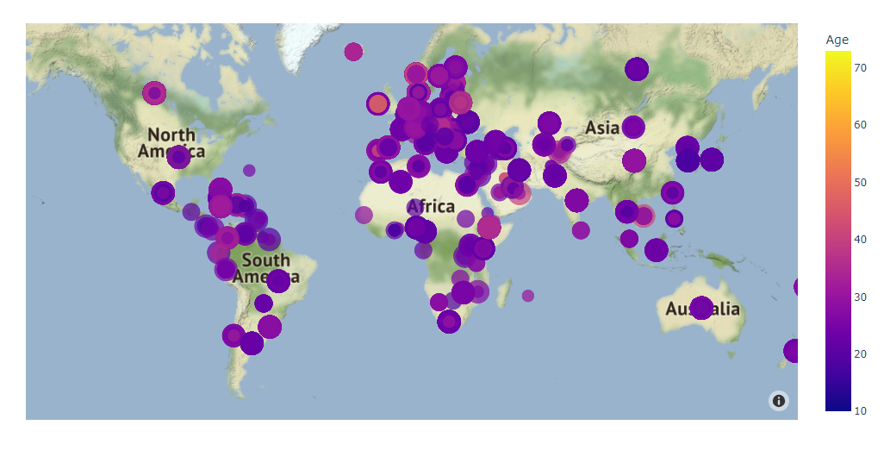
Mapping out Participation by Age

Slide 12
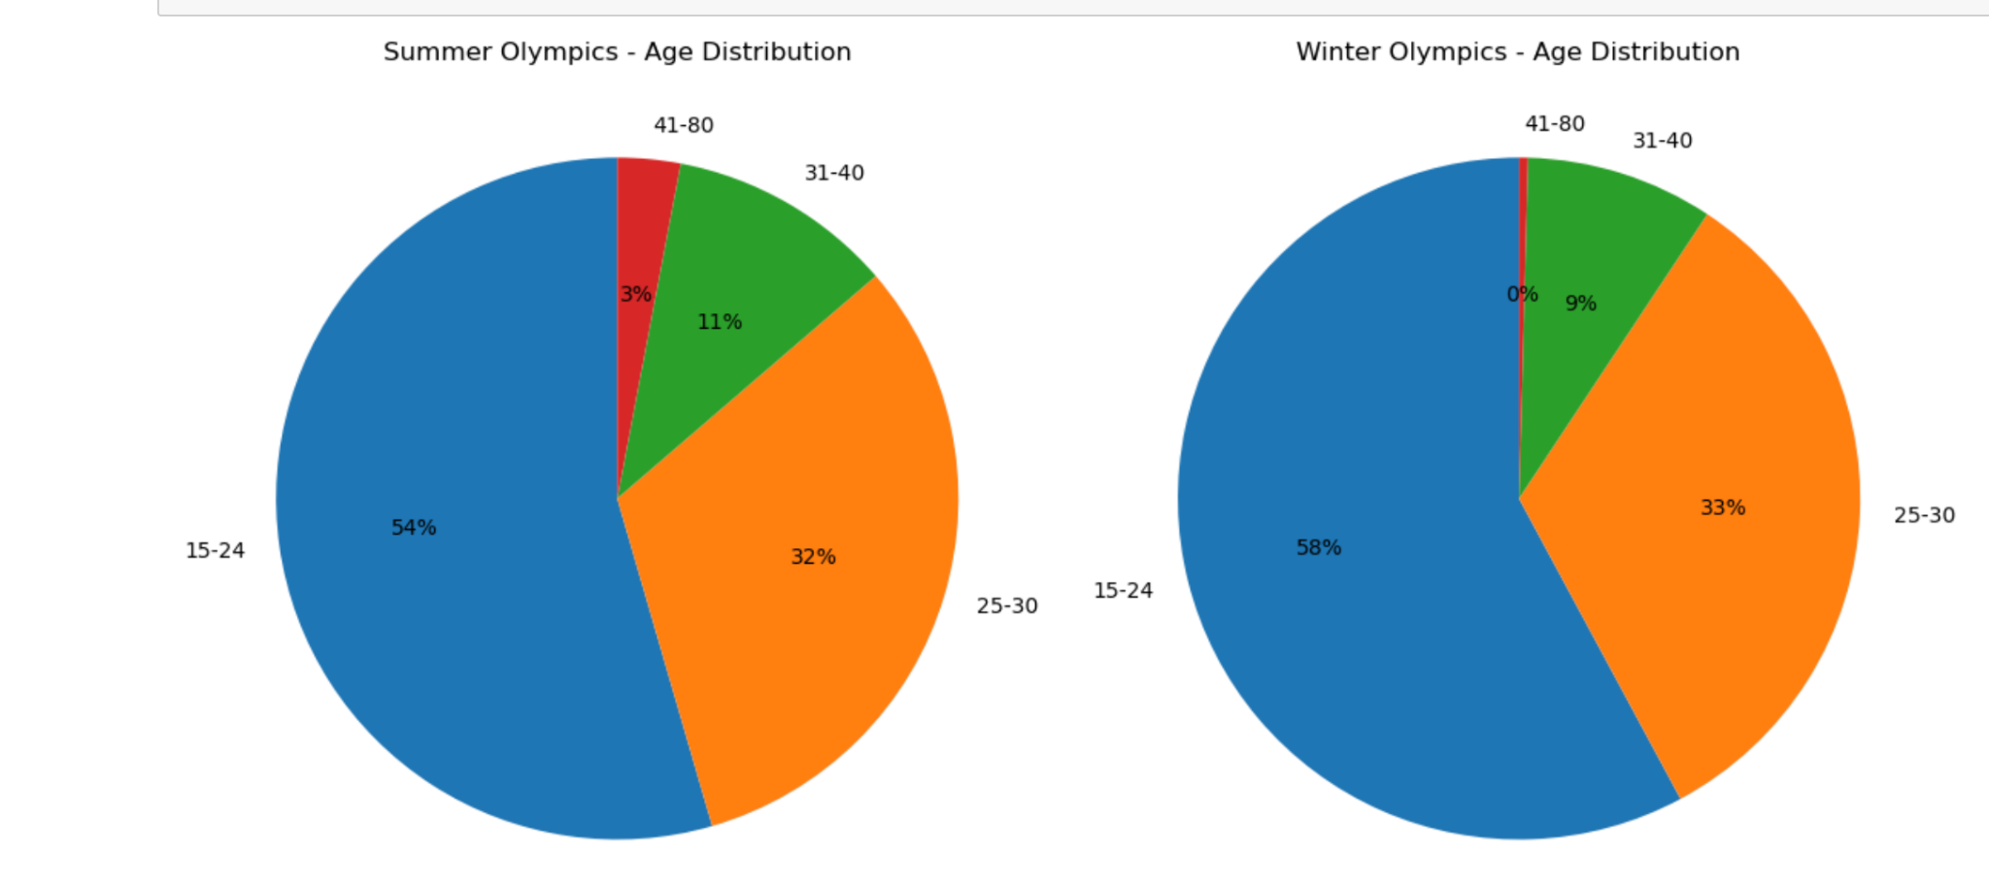
Age By Olympic Season
Alex

Slide 13
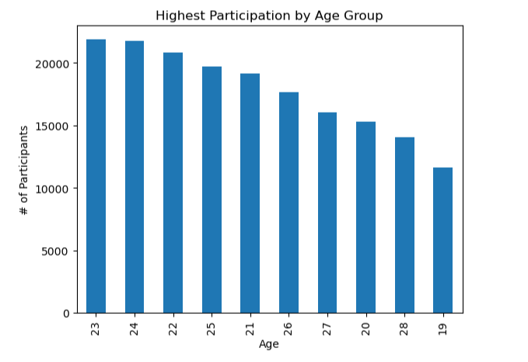
Key Visualizations – Age By Type Of Medal
Chris

Slide 14
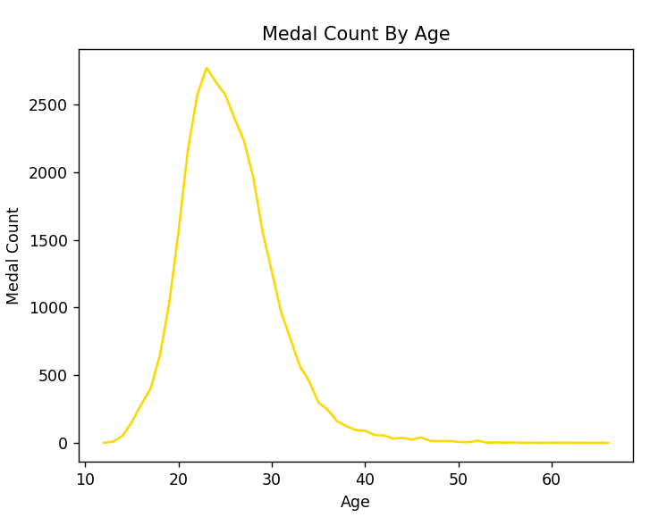
Key Visualizations – Medal Count By Age
Chris

Slide 15
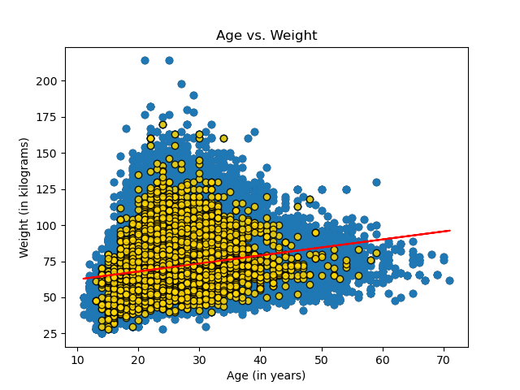
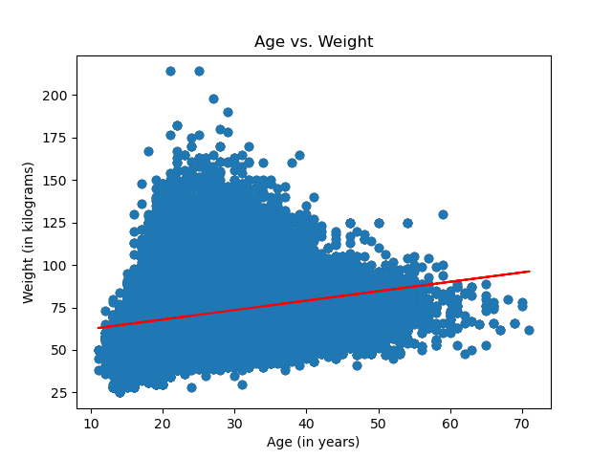
Gold Medals: Age Vs. Wght Scatter Plot & Age Round Up
Chris
y = 0.55x + 56.81

Slide 16
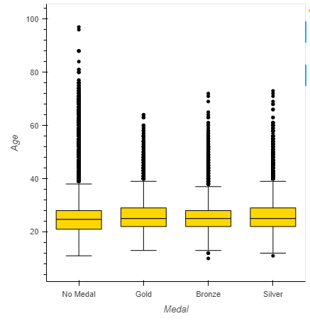
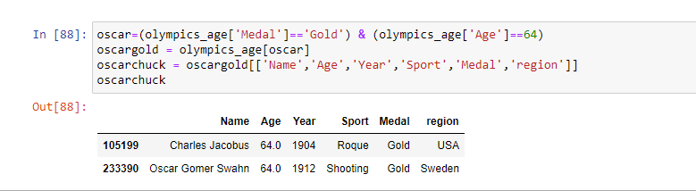
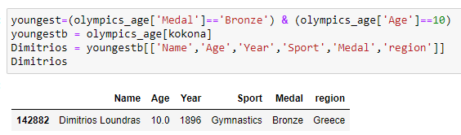
Identifying Outliers: Box & Whisker
*Oscar Gomer Swahn from Sweden and Charles Jacobus from the USA are the oldest Gold Medal Winners at age 64
*Dimitrios Loundras from Greece is the youngest medal winner at age 10!!

Slide 17
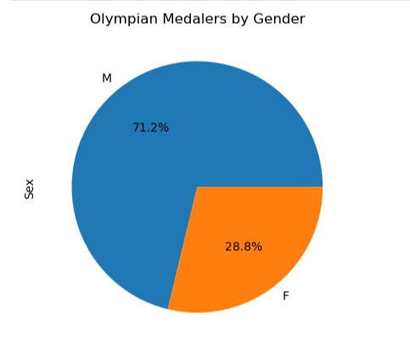
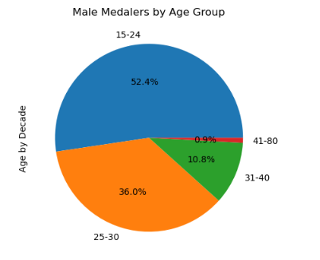
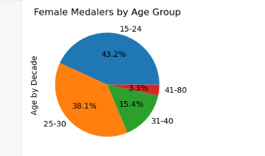
Key Visualizations - Age vs Gender
Allison

Slide 18
Findings
Allison
Top Sports: Athletics (Track & Field), Gymnastics, Swimming
Least Popular Sports: Basque Pelota, Roque Sport, Jeu De Paume
Top countries for medals include USA, Russia, Great Britain
Optimal age for medaling is in your mid 20s (23-28)
Athletes have optimized weight based on Age & Gold medalists are more finely tuned
Males have 2x+ medals than women and have slight advantage in top age category (15-24)

Slide 19
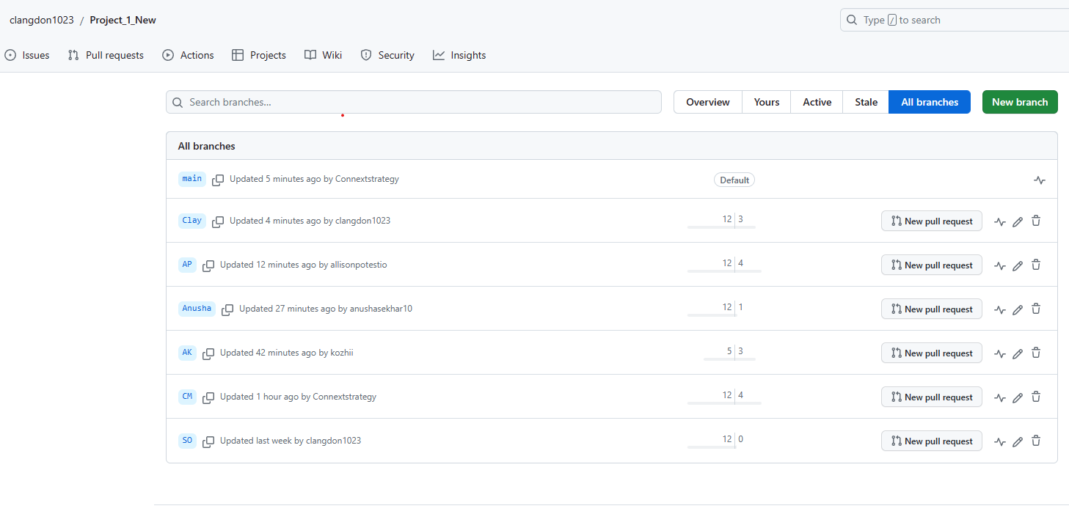
Github Structure

